Slide 1
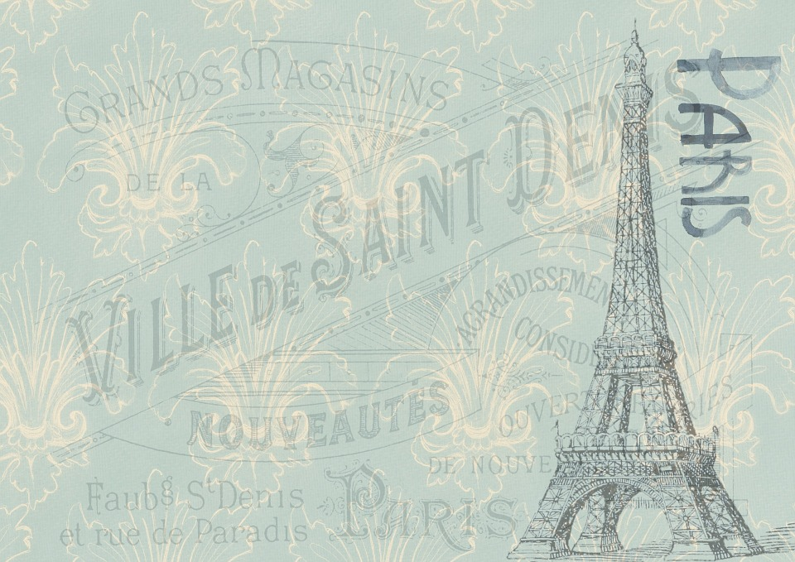














Why take
French?
le français

Slide 2
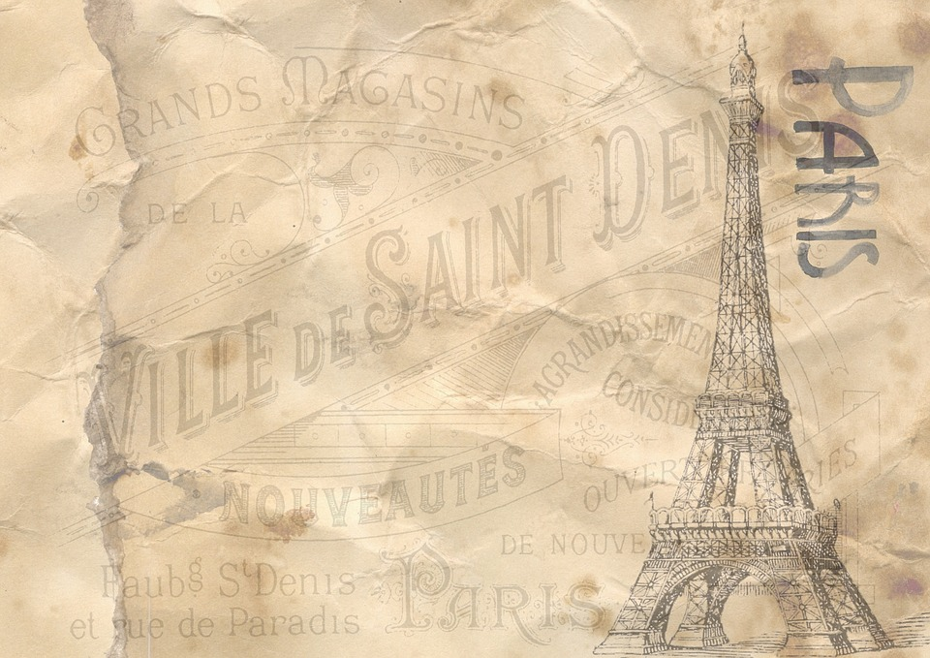


SALUT

Slide 3
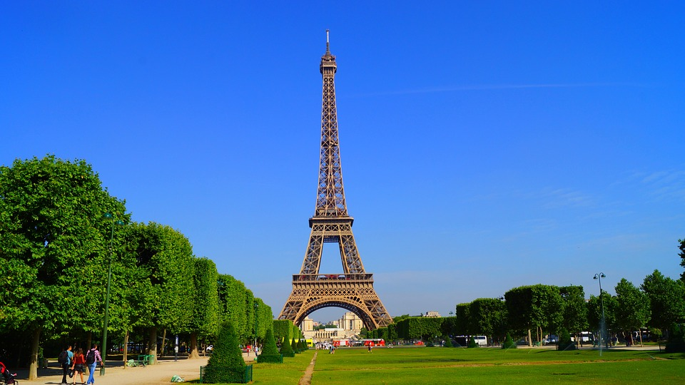
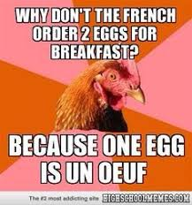
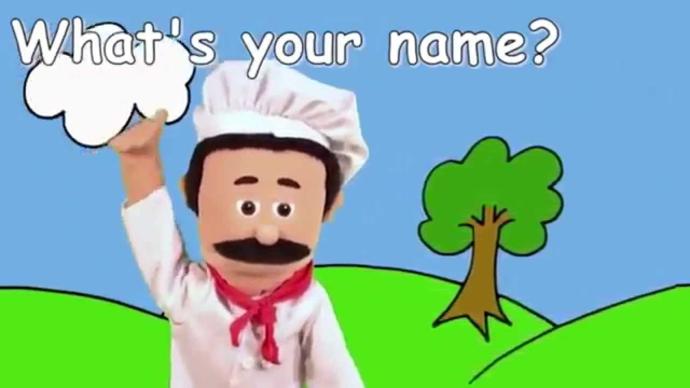
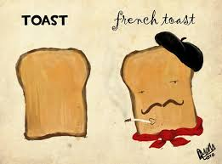
Comment t’appelles-tu?
Je m’appelle … Comment t’appelles-tu?
Je m’appelle…

Slide 4






Comment ça va?
Ça va bien!
Comment ça va?
Ça va mal!

Slide 5
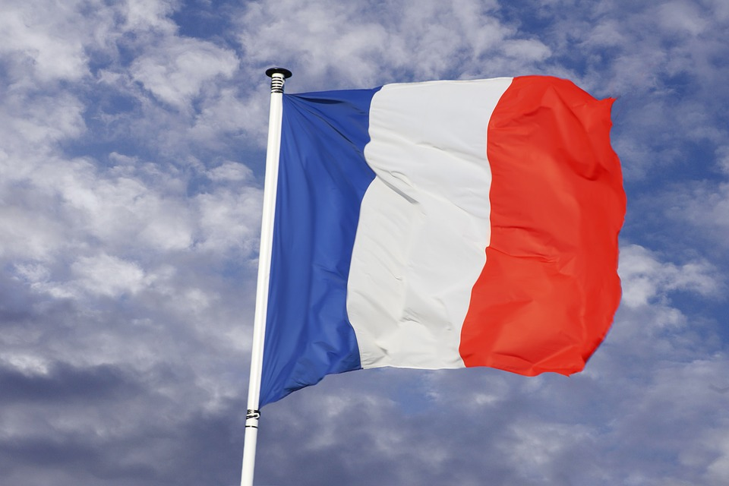
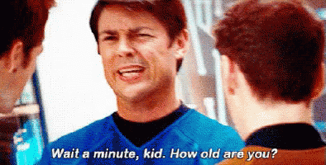
Quel âge as-tu?
J’ai … ans. Quel âge as-tu?
J’ai … ans.

Slide 6
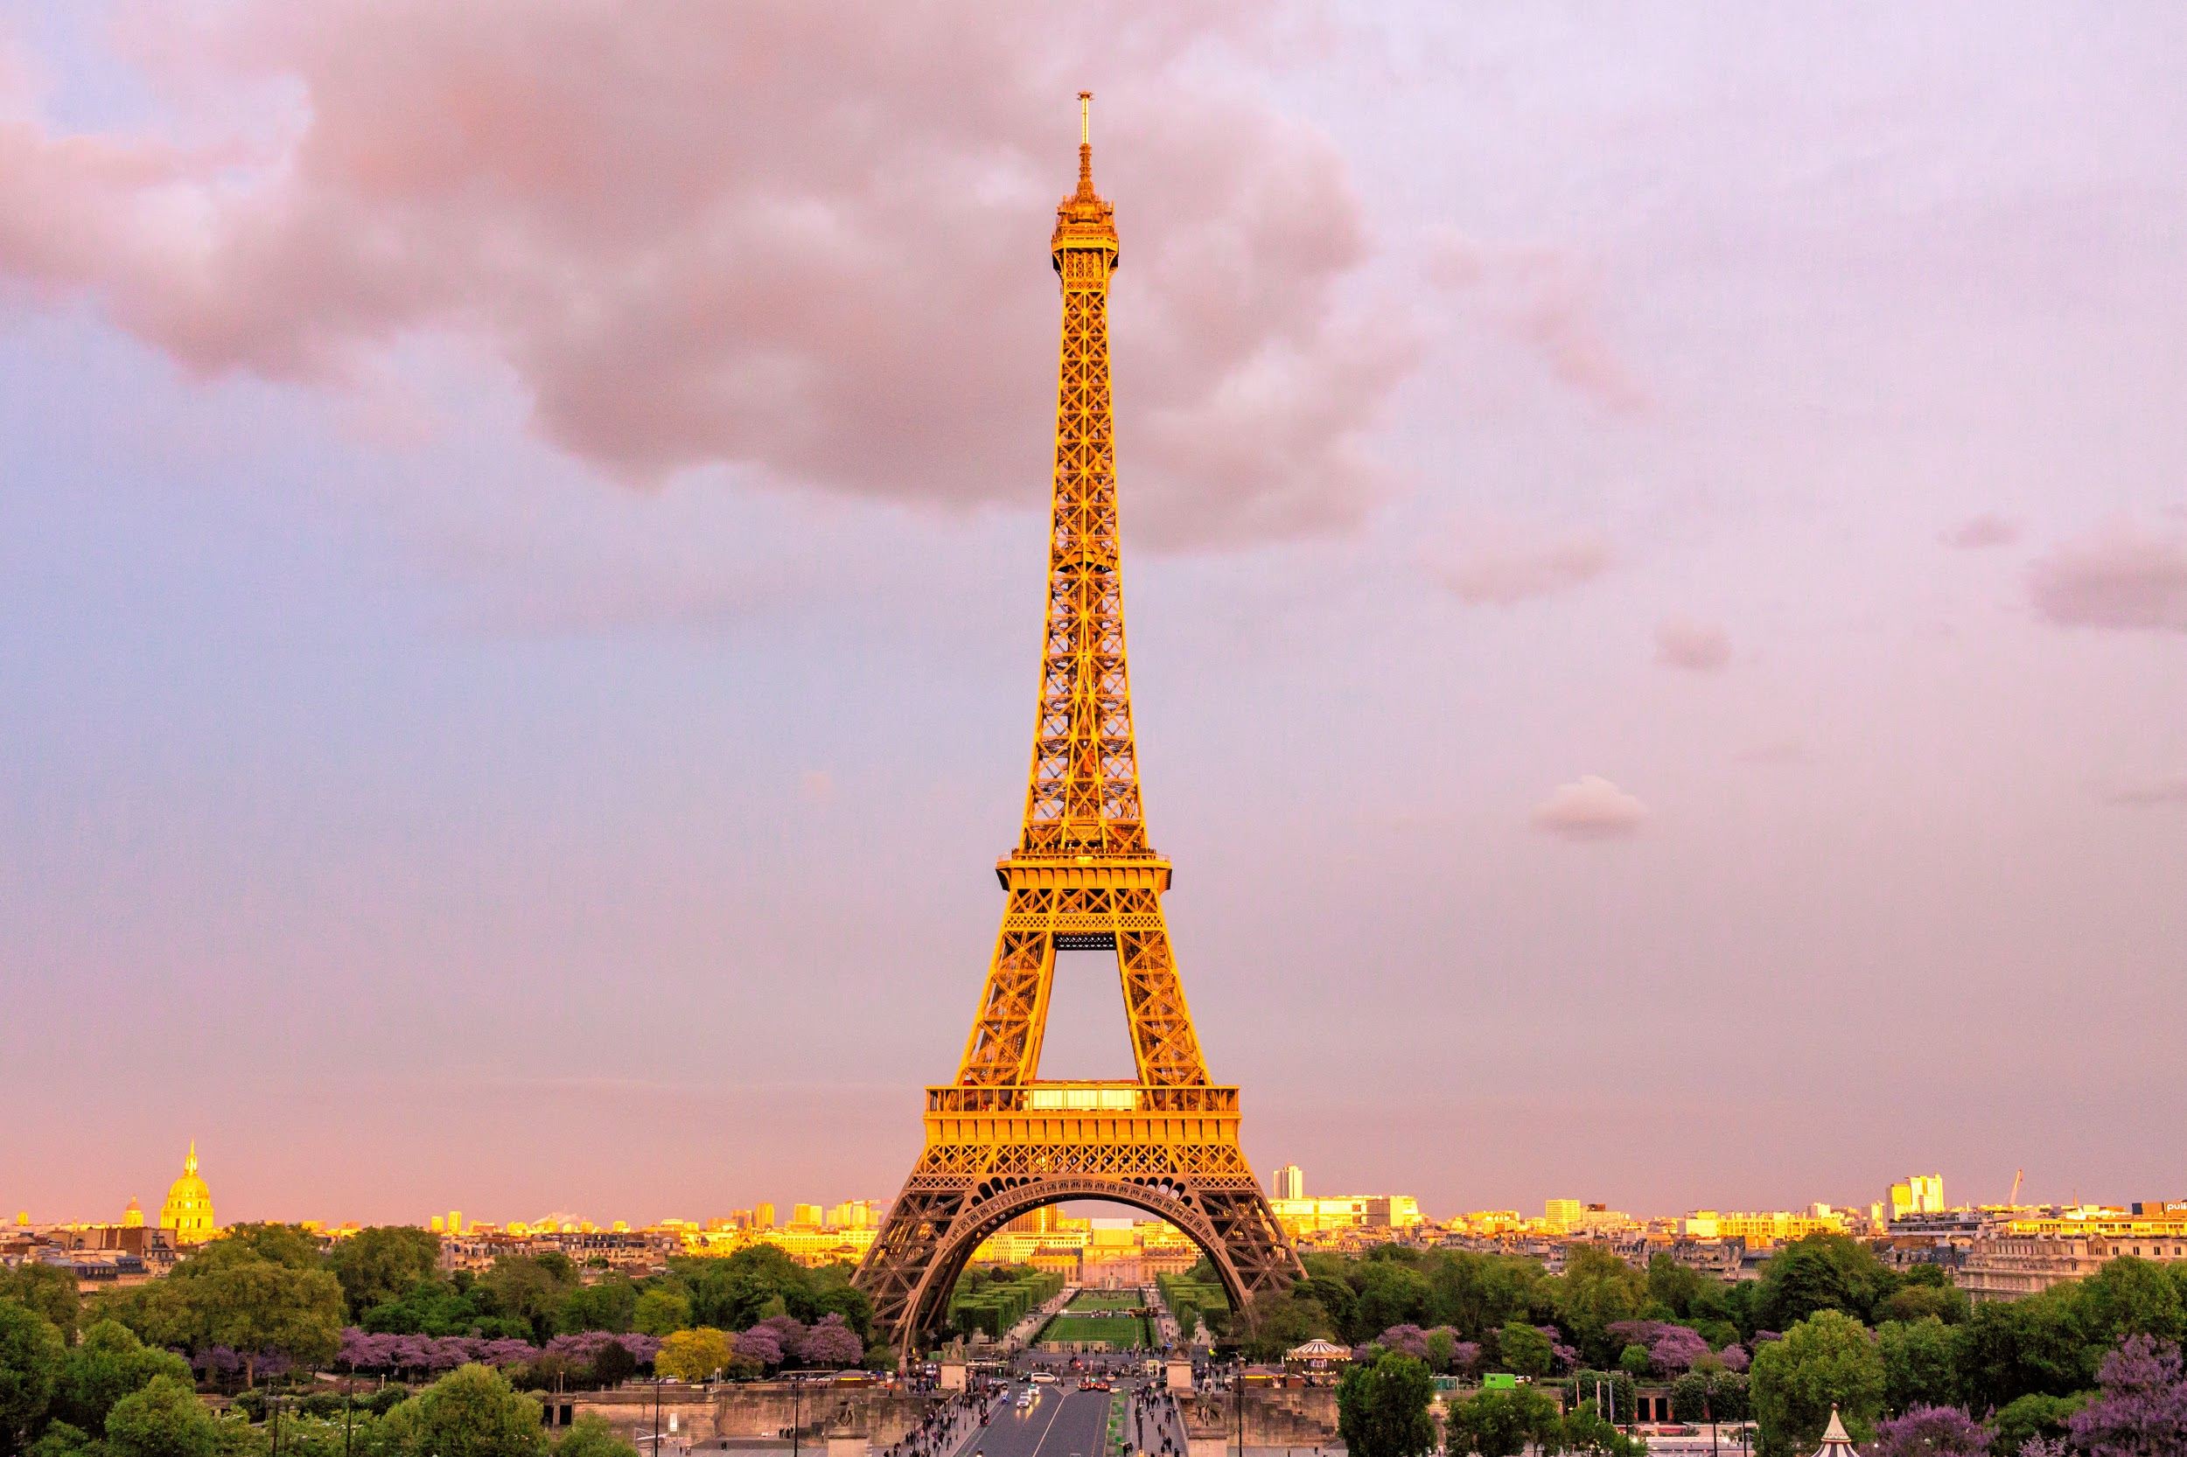

Au revoir!
Salut!

Slide 7
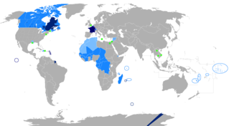

Why take French?
French is spoken in many countries.

Slide 8
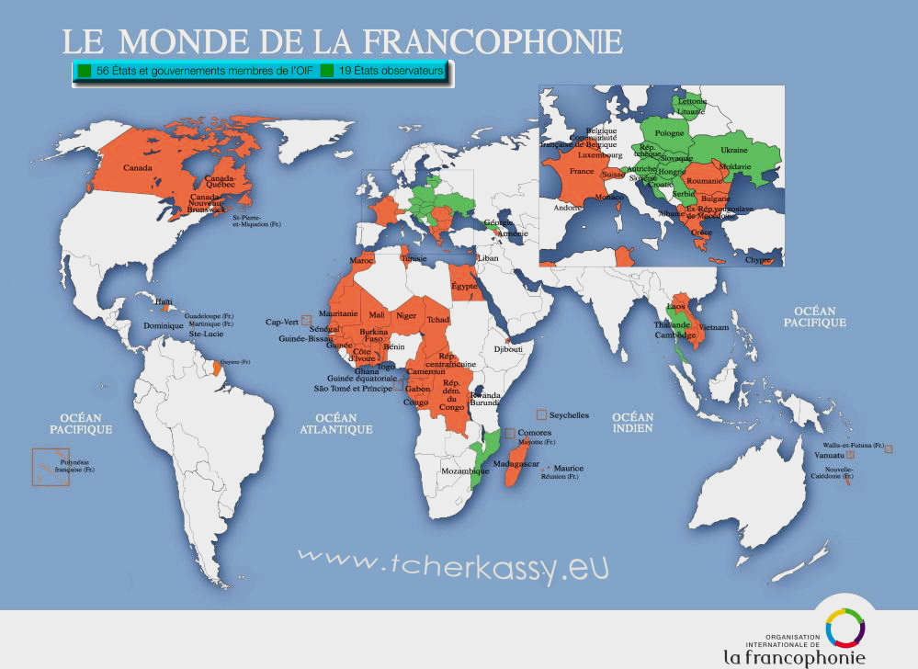
56 countries use French as their official langue.
19 more countries use French as an important language for business and international communication.

Slide 9
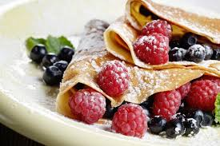
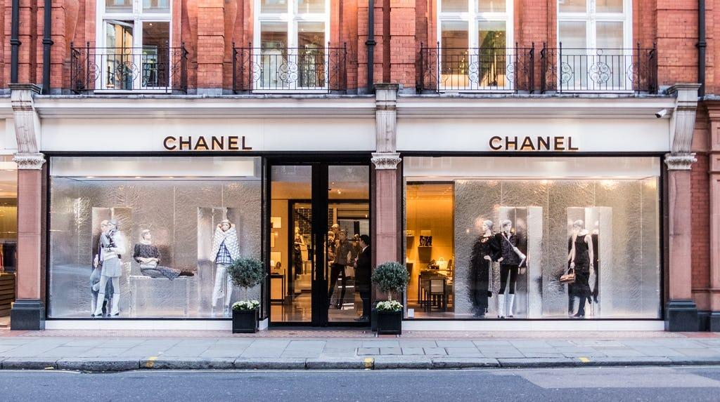
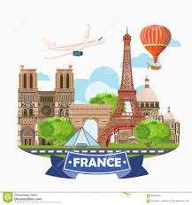
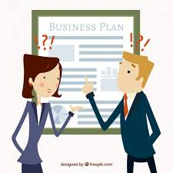
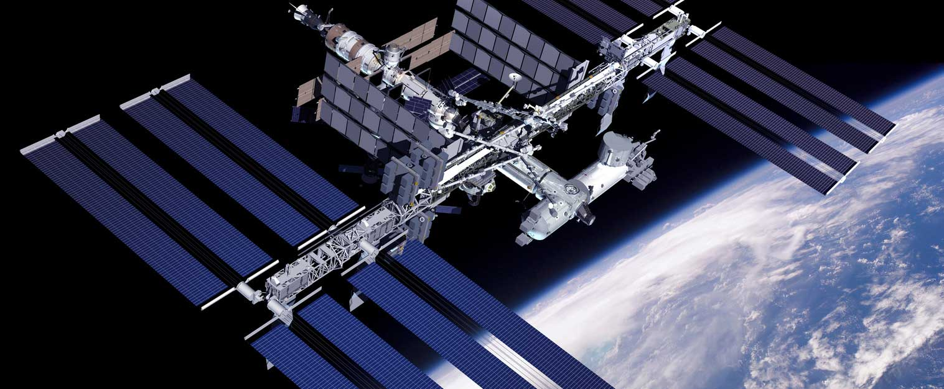
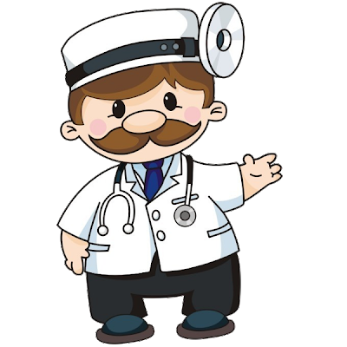

Why take French?
There are many job opportunities in:
travel
business
cooking
fashion
medicine
aerospace

Slide 10
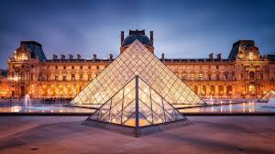
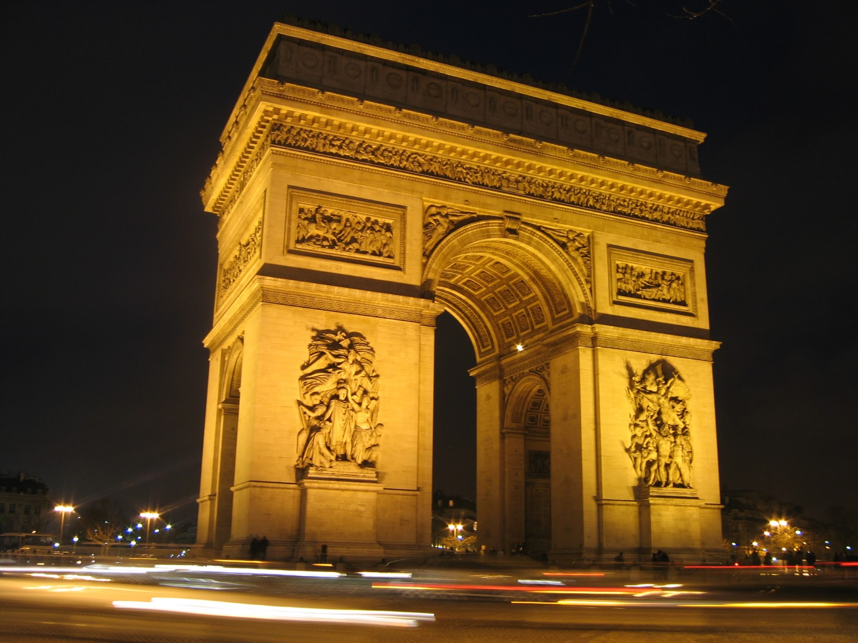
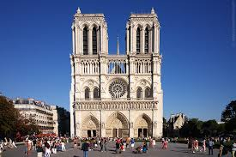
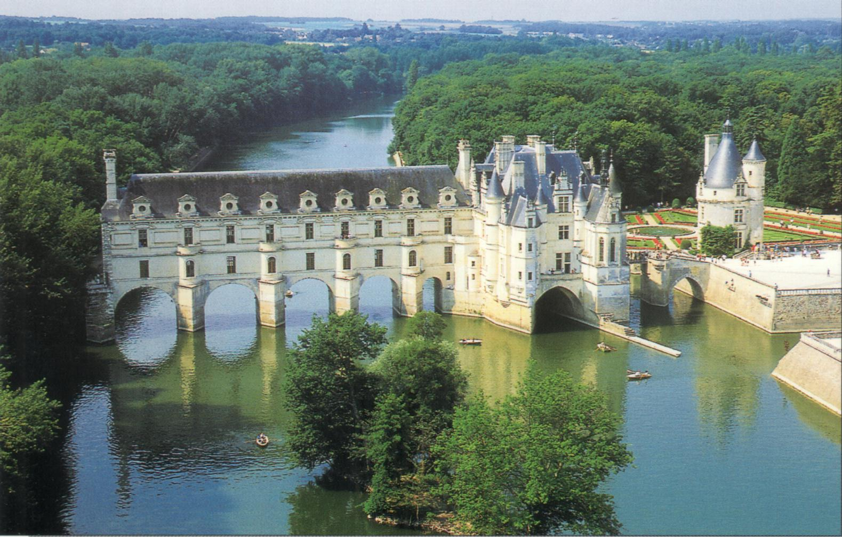
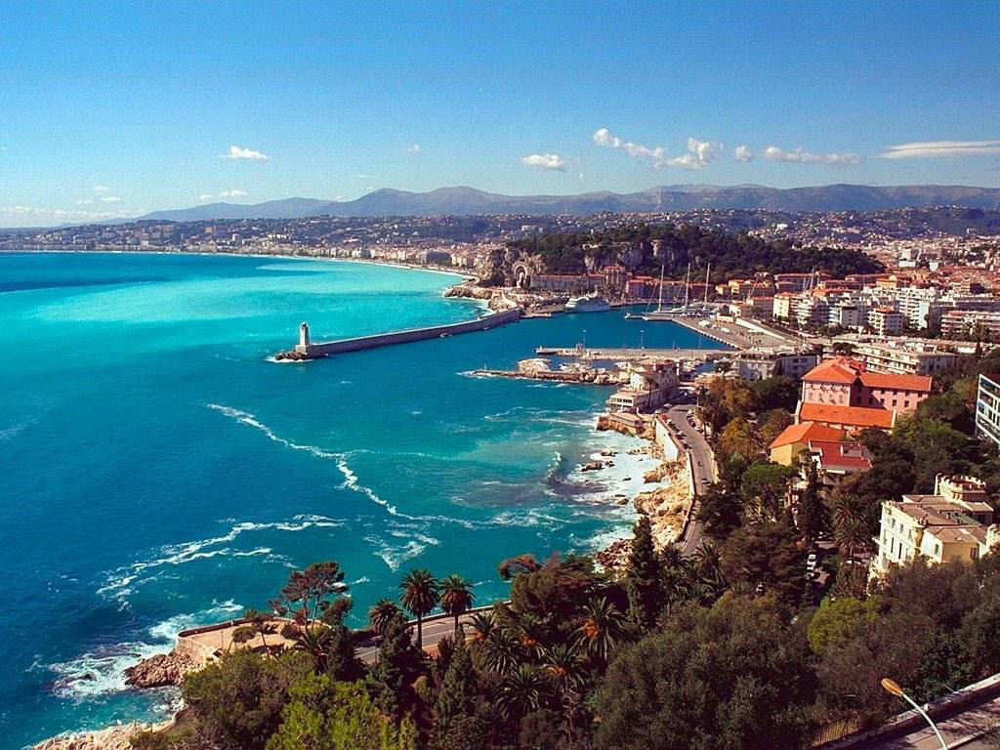
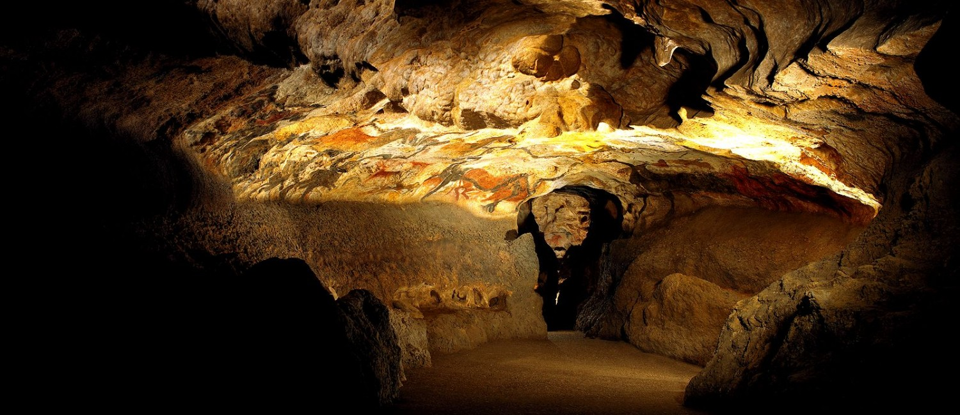
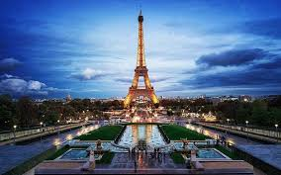
France is the #1 Tourist Destination!

Slide 11
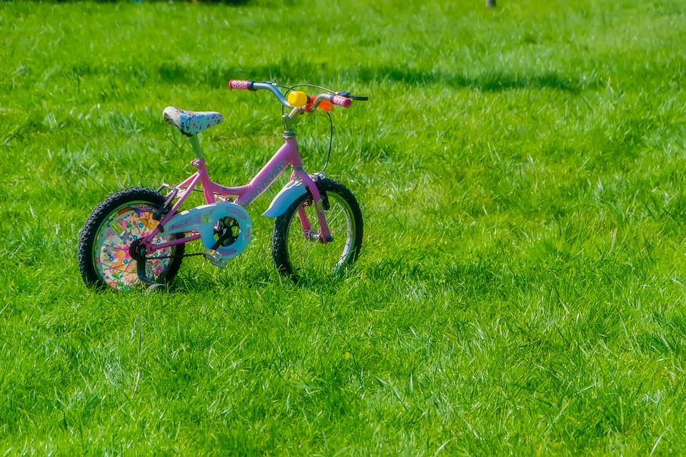
Chanson: Violette
Un = 1
Deux = 2
Trois = 3
Quatre = 4
Cinq = 5
Six = 6
Sept = 7
Un = 1
Deux = 2
Trois = 3
Quatre = 4
Cinq = 5
Six = 6
Sept = 7
Violette, Violette!
Violette
à
bicyclette!

Slide 12
Au revoir!
Salut!

