Slide 1
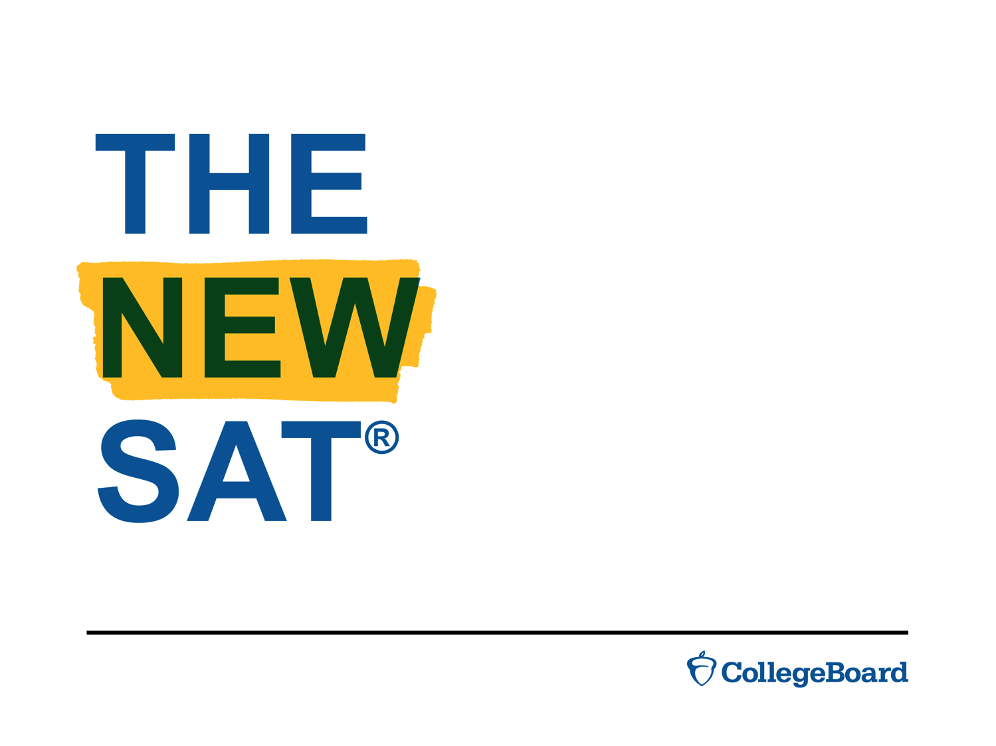

THE
NEW
SAT
®

Slide 2




Learn why the SAT® is an important step for any college-bound student
LEARN WHY THE SAT® IS AN IMPORTANT STEP FOR ANY COLLEGE-BOUND STUDENT TOTAKE AND HOW
IT IS FAIR FOR ALL.

Slide 3

Why take it
WHY
TAKE
IT
It is one of the most widely used college admission tests in the U.S.
Many schools also use it for placement and academic counseling, as well as scholarships and merit aid.
It helps students show colleges what they know and what they can do.
It’s fair. The questions are rigorously researched and tested to make sure students from all backgrounds who have equal levels of preparation have an equal chance to do well.

Slide 4


Say hello to the new standard in college assessment
SAY HELLO
TO THE NEW
STANDARD
IN COLLEGE ASSESSMENT
WITH THE
NEW SAT®.

Slide 5

The New SAT®
THE NEW SAT®
More focused, clear, and useful.
Better reflects the work students
are doing in school.
Better measures the skills
and knowledge needed to be ready
for college and career.
Connects students with opportunities, including free practice tools on Khan Academy® and college application fee waivers for income-eligible students.

Slide 6


Key calendar dates
MARCH 2016 WILL
MARK THE FIRST ADMINISTRATION
OF THE NEW SAT®.
PLAN YOUR COLLEGE ADMISSION PROCESS WITH THESE KEY CALENDAR DATES.

Slide 7

Mark your calendar
MARK
YOUR
CALENDAR
The new SAT ® launches March 2016.
Students can take the current SAT now through January 2016 and/or the new SAT in or after March 2016.
MOST U.S. COLLEGES PLAN TO ACCEPT SCORES FROM EITHER VERSION FOR THE NEXT FEW YEARS.

Slide 8



One step in the process
FROM PRACTICING TO APPLYING, TAKING THE SAT®
IS JUST ONE STEP IN THE PROCESS OF GETTING ADMITTED TO COLLEGE.

Slide 9
From SAT® to college
FROM
SAT® TO COLLEGE
Students thinking
about college should:
Talk to their school counselor about the college search and application process.
Research colleges and make a list of schools they’re interested in.
Register for the SAT and review college admission requirements.
Keep taking challenging courses
and practice regularly to show they’re ready for college-level work.

Slide 10

What’s different about the new SAT®?
WHAT’S
DIFFERENT
ABOUT THE
NEW SAT®?
TO SHOW YOU, WE’VE COMPARED THE CURRENT SAT TO THE NEW SAT.

Slide 11
The current SAT® compared to the new SAT®
THE CURRENT SAT® COMPARED TO THE NEW SAT
Current SAT
Total testing time:
3 hours, 45 min.
4 sections: Critical Reading,
Writing, Mathematics, Essay
Essay: Required
Penalized for wrong answers
Score scale: 600 to 2400
New SAT
Total testing time:
3 hours (+50 minutes if taking the SAT with Essay)
2 sections (3 with SAT Essay):
Evidence-Based Reading and Writing, Math
Essay: Optional
No penalty for guessing
Score scale: 400 to 1600;
Essay scored separately
SAT FEE WAIVERS WILL CONTINUE TO BE AVAILABLE FOR ALL ELIGIBLE STUDENTS TO USE WITH EITHER VERSION OF THE SAT.

Slide 12


Five things students need to know
FIVE THINGS STUDENTS NEED
TO KNOW ABOUT THE NEW SAT®.

Slide 13
Rights-only scoring
ABOUT THE NEW SAT®
1. Rights-only scoring.
Students earn points
for each correct answer.
There’s no penalty
for guessing.
Students are encouraged to read each question and select the answer they think is best.

Slide 14
No obscure vocabulary
ABOUT THE NEW SAT®
2. No obscure vocabulary.
The new SAT focuses on words students are most likely to use
again throughout college and career.
Students won’t see words like “prevaricate” or “sagacious.”
They will need to understand how
words like “synthesis” or “alleviate”
are used in context.

Slide 15
More focused math
ABOUT THE NEW SAT®
3. More focused math.
Focuses on the math skills most widely used in college and career.
Most questions are multiple choice.
Calculators are allowed on only one section. Some questions are easier to solve without a calculator.

Slide 16
Analysis, not opinion
ABOUT THE NEW SAT®
4. Analysis, not opinion.
The SAT Essay will ask students to read
a passage and:
Provide a written analysis of the text.
Use critical reasoning skills to show how the author builds an argument.
Use evidence from the text to
support their analysis.
Students should check individual
college websites to see if schools they’re interested in require the SAT Essay.

Slide 17
Free, world-class test practice for all
ABOUT THE NEW SAT®
5. Free, world-class test
practice for all.
Free Official SAT Practice on Khan Academy® created in partnership with the College Board.
Personalized practice pathways provided to each student.
Full-length practice tests and thousands of sample questions.
Accessible through any computer with Internet access.
Materials also available to print.

Slide 18

What about the PSAT/NMSQT® and PSAT™ 8/9?
THE SAT®
HAS BEEN REDESIGNED,
BUT WHAT
ABOUT THE
PSAT/NMSQT®
AND PSAT™ 8/9?

Slide 19
The Redesigned PSAT/NMSQT®
THE REDESIGNED
PSAT/NMSQT®
Aligned with the new SAT®; common score scale with the SAT and PSAT™ 8/9.
October 2015 is the first administration. The PSAT™ 10 (the same test as the PSAT/NMSQT) is administered to sophomores in the spring.
More scholarship opportunities, connections to challenging course work, and access to fee waivers.
STUDENTS SHOULD TALK TO THEIR SCHOOL COUNSELOR IF THEY’RE INTERESTED IN TAKING THE PSAT/NMSQT.

Slide 20
PSAT™ 8/9
PSAT™ 8/9
Tightly aligned with the SAT® and PSAT/NMSQT®; common score scale.
Establishes a baseline for college and career readiness as students enter high school.
Offered in the fall and spring.

Slide 21
For more information
FOR MORE
INFORMATION
About the redesigned
SAT®, PSAT/NMSQT® ,
and PSAT™ 8/9:
sat.org/new
About SAT practice on Khan Academy:
satpractice.org
For general SAT info:
sat.collegeboard.org
@OfficialSAT

