Slide 1
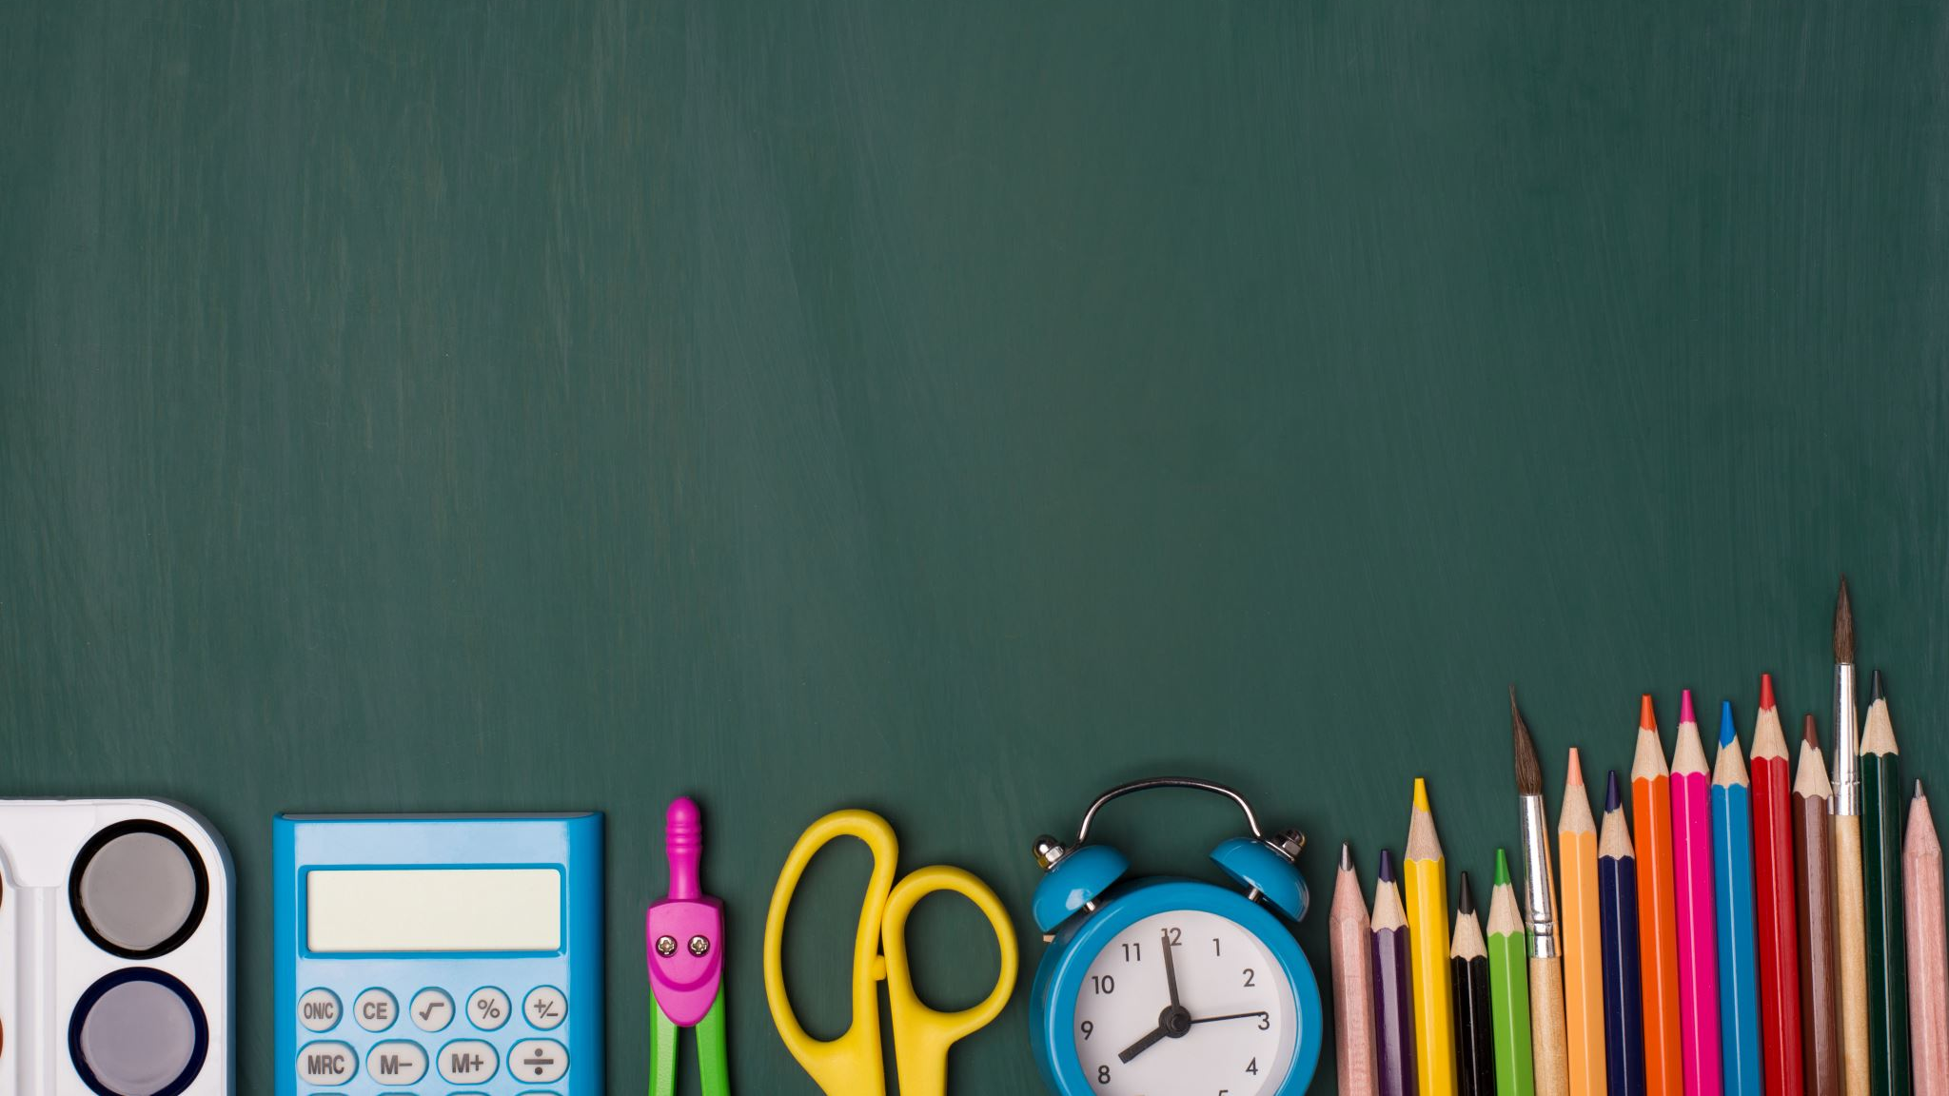
Welcome to Back to School Night! 2023-24 School Year
Mr. Putnam or Mr. P

Slide 2
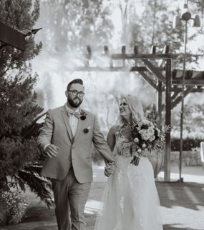
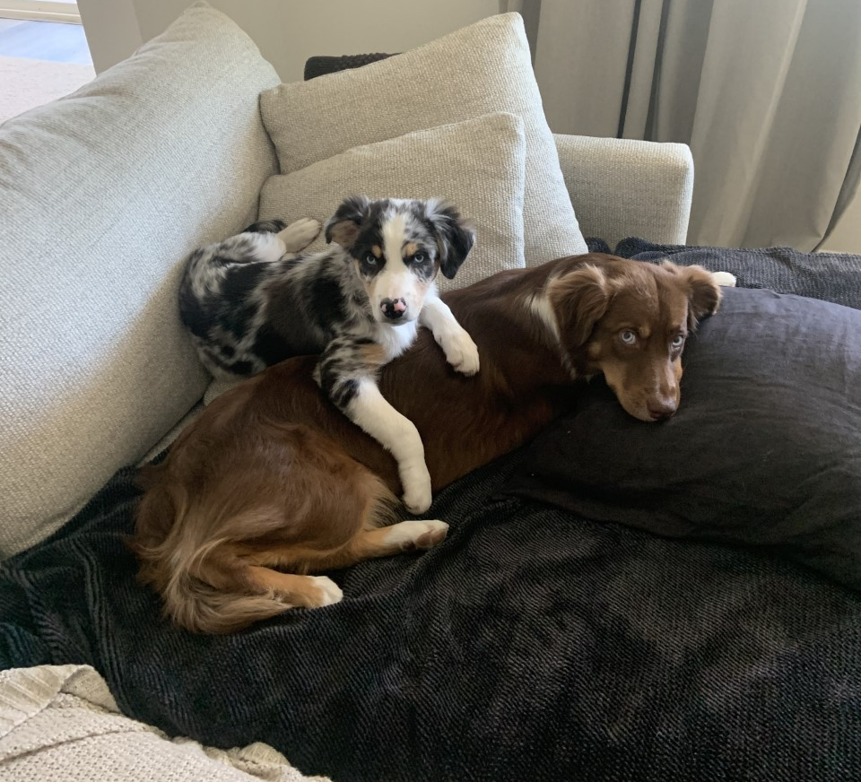
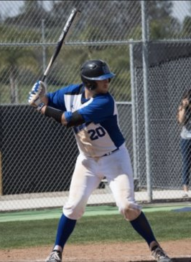
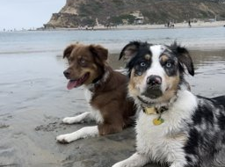
About me:
College at CSUSM- Baseball
5th year teaching, 2nd year in Murrieta
Taught in San Marcos prior to this year
My Wife teaches at Murrieta Elementary
2 Puppies
Go Padres!

Slide 3
Contact Info:
Email: jputnam@murrieta.k12.ca.us
Phone: 951-894-5750 Ext.6582
Contact through Aeries Via ParentSquare or Canvas

Slide 4
P. 1 & 7- Modern World History
Providing Co-Teaching support in the general education classroom.
Pull out support for tests
Resources for students and staff
Additional support for all student and staff
Please see Mr. Dowden's Back to School presentation for more information!

Slide 5
P. 5- Study Skills
In this class we will work on academic and lifelong learning goals. Incorporating post-secondary learning along with maintaining grades and assignments in all of our classes is a goal of this class. I love to work with students to prepare them for their futures, and we will do just that in this class! A main focus of this class is a weekly check-in that must be completed by Friday of each week to plan and prepare for the following week. This check-in is completed using Microsoft Forms and will allow students to focus on what they need to do to be successful in their classes.

Slide 6
P. 2- US History
Providing Co-Teaching support in the general education classroom.
Pull out support for tests
Resources for students and staff
Additional support for all student and staff
Please see Mr. Dowden's Back to School presentation for more information!

