Slide 1
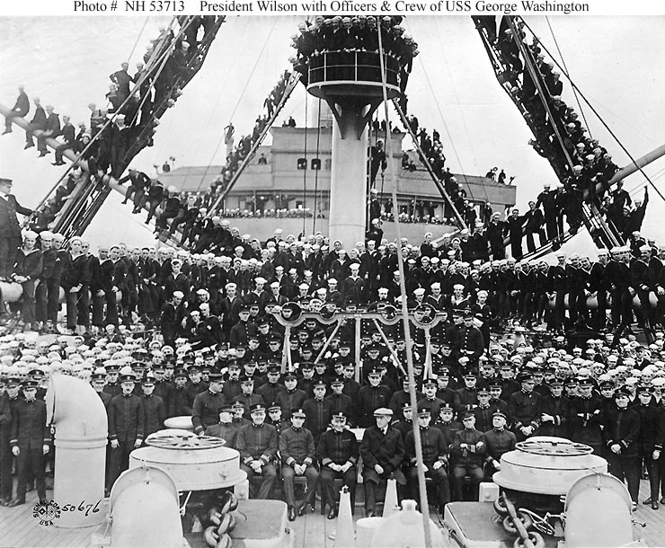
A Return to Normalcy
Working for Peace
War Debts
Dawes Plan
Limiting Immigration
Teapot Dome Scandal

Slide 2
Working for Peace
Post war issues: war debts, arms controls, reconstruction of war torn countries
Kellogg-Briand Pact 1929
  64 nations agreed to renounce war as a means of solving international problems
  Unable to enforce: no military or economic plan against a country that violated this

Slide 3
War Debts
Britain and France borrowed $10 billion from American banks in WWI
They could only pay back debt in two ways:
  Exporting more than they imported
  Collecting reparations from Germany
Fordney-McCumber Tariff
  Raised taxes on imports to highest level
  Result: No foreign competition = Britain and France not being able to sell their goods (#1)
  They then demanded Germany to pay back their debt, but Germany has no $ to give

Slide 4
Dawes Plan
U.S. banks loaned Germany $2.5 billion so Germany could pay reparations to Britain and France
Britain and France used that $ to pay their debt owed to U.S. banks
Result: U.S. Paid themselves with their own money (revolving door)

Slide 5
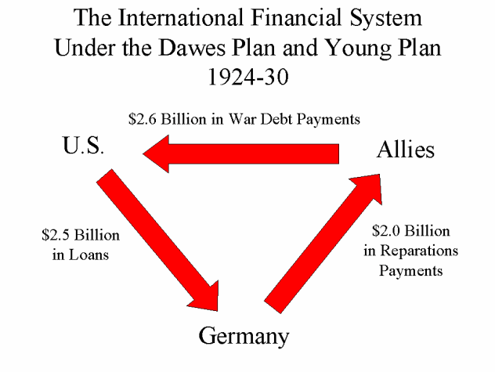

Slide 6
Limiting Immigration
Nativist attitudes
Demand for unskilled labor decreased after WWI
  Immigrants were this labor
Emergency Quota Act 1921
  Set a max # of people who could enter the country
  Limited immigration from Eastern and Southern Europe (Catholics and Jews)
  Japanese immigration was excluded
  Did not apply to the western hemisphere (Canada and Mexico had open immigration)

Slide 7
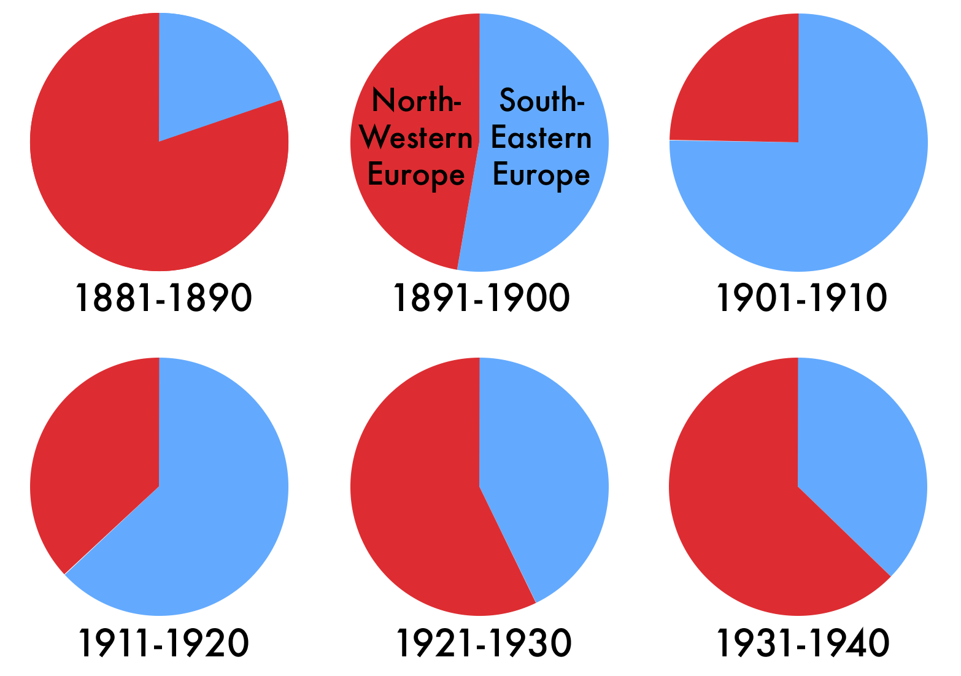
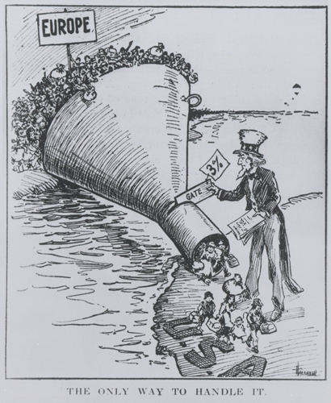

Slide 8
Teapot Dome Scandal
President Harding’s Secretary of Interior: Albert Fall
Fall secretly leased oil-rich public land in Wyoming and California to private companies in return for money and land
Fall claimed these contracts were in government interest, but he also had $325,000 in bonuses and cash

Slide 9
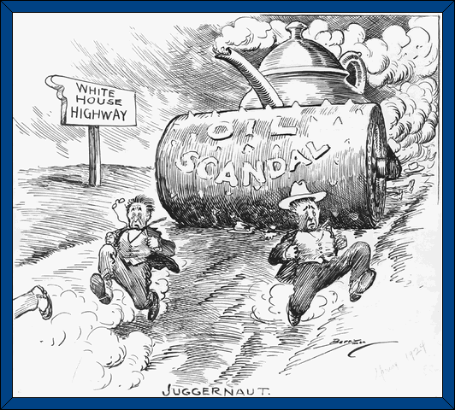
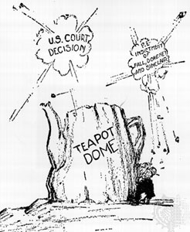

Slide 10
